Slide 1
Deadlocks

Slide 2
Chapter 7: Deadlocks
The Deadlock Problem
System Model
Deadlock Characterization
Methods for Handling Deadlocks
Deadlock Prevention
Deadlock Avoidance
Deadlock Detection
Recovery from Deadlock

Slide 3
Objectives
To develop a description of deadlocks, which prevent sets of concurrent processes from completing their tasks
To present a number of different methods for preventing or avoiding deadlocks in a computer system

Slide 4
The Deadlock Problem
A set of blocked processes each holding a resource and waiting to acquire a resource held by another process in the set
Example
System has 2 disk drives
P₁ and P₂ each hold one disk drive and each needs another one
An example from US Kansas law:
“When two trains approach each other at a crossing, both shall come to a full stop and neither shall start up again until the other has gone.”

Slide 5
Bridge Crossing Example
Traffic only in one direction
Each section of a bridge can be viewed as a resource
If a deadlock occurs, it can be resolved if one car backs up (preempt resources and rollback)
Several cars may have to be backed up if a deadlock occurs
Starvation is possible
Note – Most OSes do not prevent or deal with deadlocks

Slide 6
System Model
Resource types R₁, R₂, . . ., R_{m}
CPU cycles, memory space, I/O devices
Each resource type R_{i} has W_{i} instances.
Each process utilizes a resource as follows:
request
use
release

Slide 7
Deadlock Characterization
Deadlock can arise if four conditions hold simultaneously.
Mutual exclusion: only one process at a time can use a resource
Hold and wait: a process holding at least one resource is waiting to acquire additional resources held by other processes
No preemption: a resource can be released only voluntarily by the process holding it, after that process has completed its task
Circular wait: there exists a set {P₀, P₁, …, P_{n}} of waiting processes such that P₀ is waiting for a resource that is held by P₁, P₁ is waiting for a resource that is held by
P₂, …, P_{n–1} is waiting for a resource that is held by P_{n}, and P_{n} is waiting for a resource that is held by P₀.

Slide 8
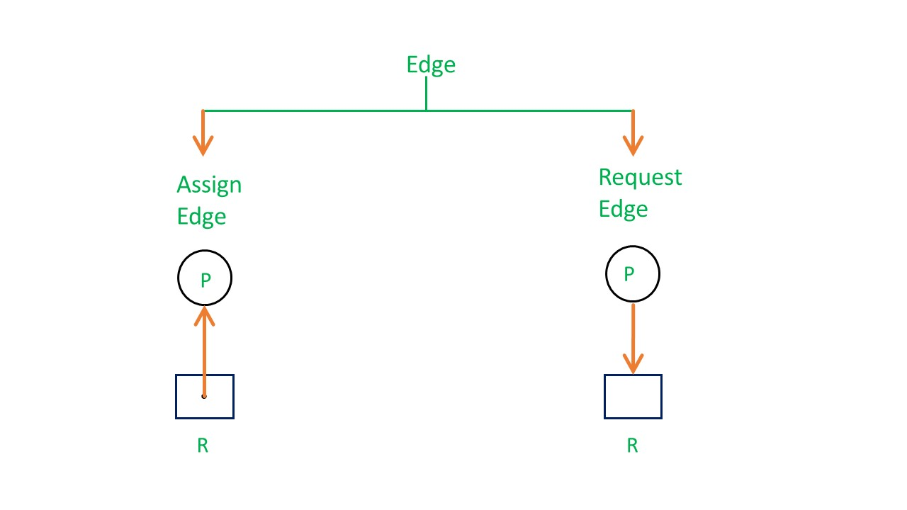
Resource-Allocation Graph
A set of vertices V and a set of edges E.
V is partitioned into two types:
P = {P₁, P₂, …, P_{n}}, the set consisting of all the processes in the system
R = {R₁, R₂, …, R_{m}}, the set consisting of all resource types in the system
request edge – directed edge P_{i} → R_{j}
assignment edge – directed edge R_{j} → P_{i}

Slide 9
Resource-Allocation Graph (Cont.)
Process
Resource Type with 4 instances
P_{i} requests instance of R_{j}
P_{i} is holding an instance of R_{j}
P_{i}
R_{j}
P_{i}
R_{j}

Slide 10
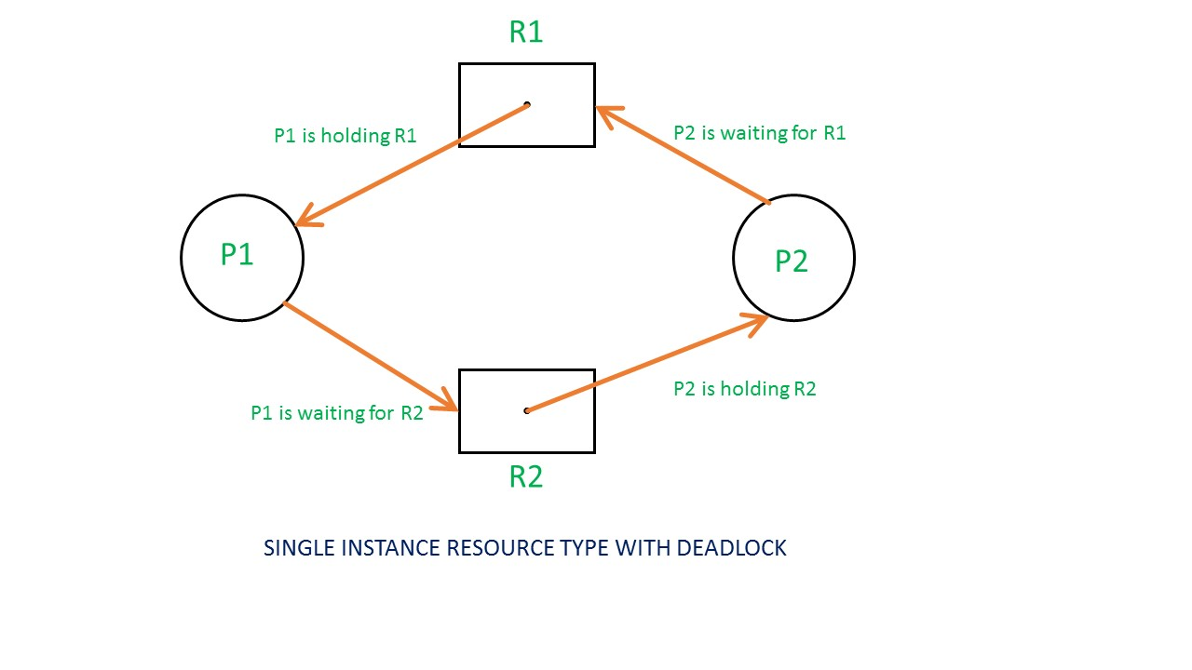
Example of a Resource Allocation Graph
Single instances RAG

Slide 11
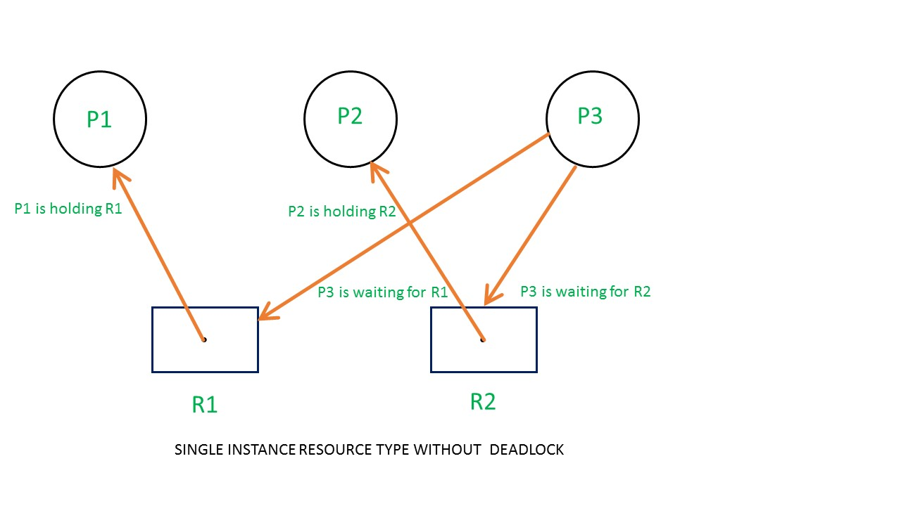
Example of a Resource Allocation Graph
Single instances RAG

Slide 12
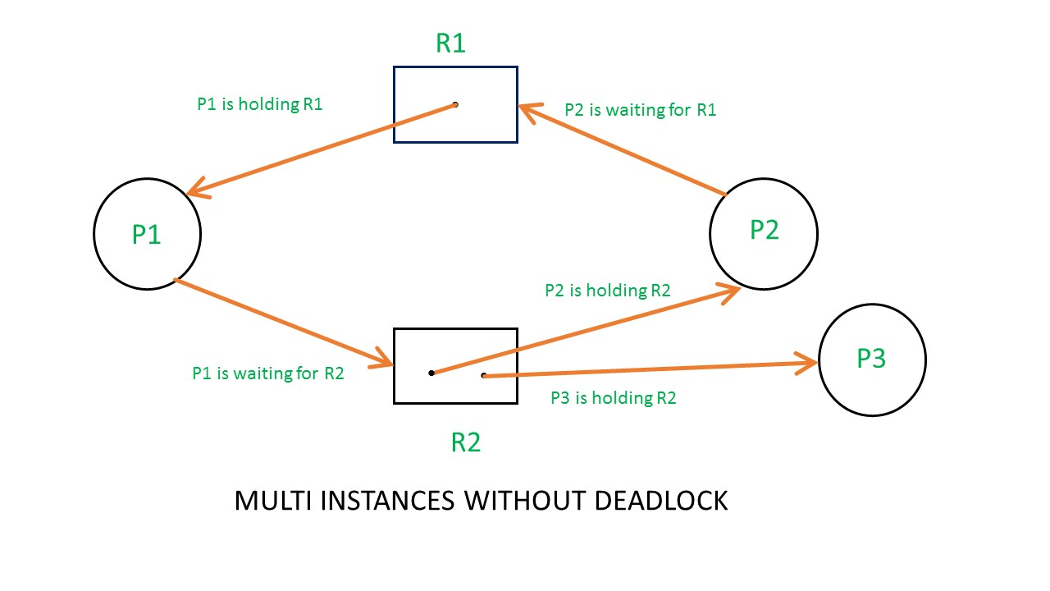
Example of a Resource Allocation Graph
Multi-instances RAG

Slide 13
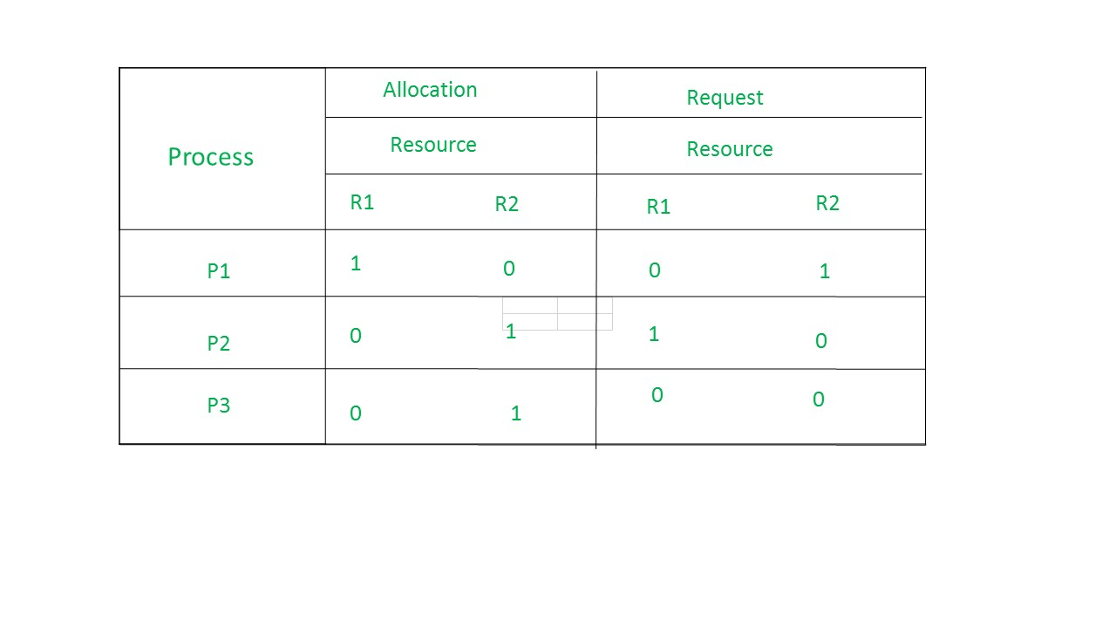
Example of a Resource Allocation Graph
Multi-instances RAG
allocation matrix and request matrix.

Slide 14
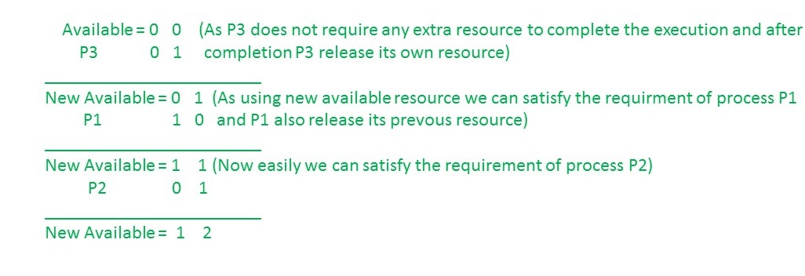
Example of a Resource Allocation Graph
Multi-instances RAG
Checking deadlock (safe or not)

Slide 15
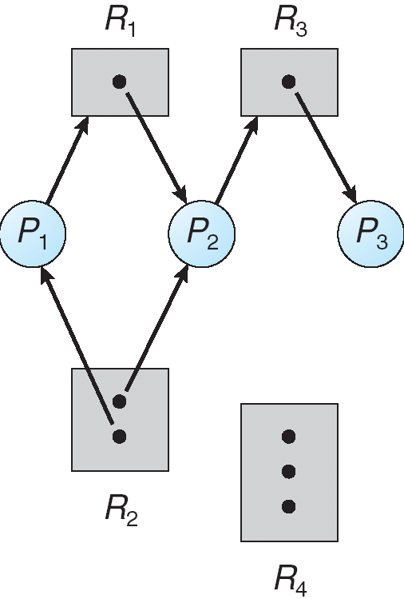
Example of a Resource Allocation Graph

Slide 16
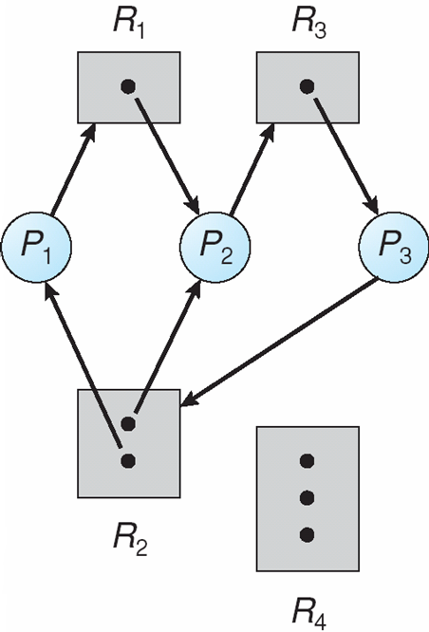
Resource Allocation Graph With A Deadlock

Slide 17
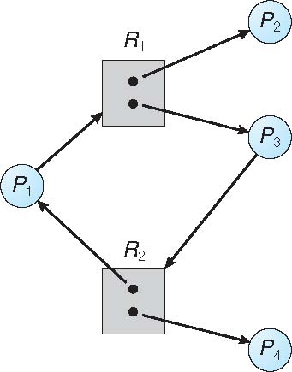
Graph With A Cycle But No Deadlock

Slide 18
Basic Facts
If graph contains no cycles ⇒ no deadlock
If graph contains a cycle ⇒
if only one instance per resource type, then deadlock
if several instances per resource type, possibility of deadlock

Slide 19
Methods for Handling Deadlocks
Ensure that the system will never enter a deadlock state
Allow the system to enter a deadlock state and then recover
Dynamic avoidance by careful resource allocation
Prevention, by structurally negating one of the four required conditions
Ignore the problem and pretend that deadlocks never occur in the system; used by most operating systems, including UNIX
OSTRICH ALGORITHM
Stick your head in the sand and pretend there is no problem at all.

Slide 20
Deadlock Prevention
Restrain the ways request can be made
Mutual Exclusion – not required for sharable resources; must hold for nonsharable resources
Hold and Wait – must guarantee that whenever a process requests a resource, it does not hold any other resources
Require process to request and be allocated all its resources before it begins execution, or allow process to request resources only when the process has none
Low resource utilization; starvation possible

Slide 21
Deadlock Prevention (Cont.)
No Preemption –
If a process that is holding some resources requests another resource that cannot be immediately allocated to it, then all resources currently being held are released
Preempted resources are added to the list of resources for which the process is waiting
Process will be restarted only when it can regain its old resources, as well as the new ones that it is requesting
Circular Wait – impose a total ordering of all resource types, and require that each process requests resources in an increasing order of enumeration

Slide 22
Deadlock Avoidance
Requires that the system has some additional a priori information available
Simplest and most useful model requires that each process declare the maximum number of resources of each type that it may need
The deadlock-avoidance algorithm dynamically examines the resource-allocation state to ensure that there can never be a circular-wait condition
Resource-allocation state is defined by the number of available and allocated resources, and the maximum demands of the processes

Slide 23
Safe State
When a process requests an available resource, system must decide if immediate allocation leaves the system in a safe state
System is in safe state if there exists a sequence <P₁, P₂, …, P_{n}> of ALL the processes in the systems such that for each P_{i}, the resources that P_{i} can still request can be satisfied by currently available resources + resources held by all the P_{j}, with j < I
That is:
If P_{i} resource needs are not immediately available, then P_{i} can wait until all P_{j} have finished
When P_{j} is finished, P_{i} can obtain needed resources, execute, return allocated resources, and terminate
When P_{i} terminates, P_{i +1} can obtain its needed resources, and so on

Slide 24
Safe State
Example – A state is said to be safe if there is some scheduling order in which every process can run to completion even if all of them suddenly request their maximum number of resources immediately.

Slide 25
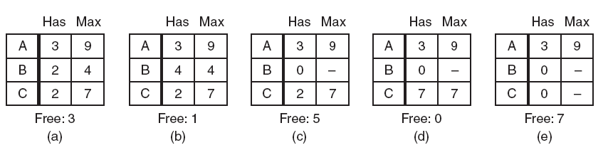
Safe State
Figure demonstration that the state in (a) is safe

Slide 26
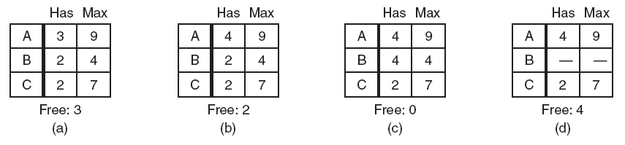
Safe State
Figure demonstration that the state in (b) is not safe

Slide 27
Basic Facts
If a system is in safe state ⇒ no deadlocks
If a system is in unsafe state ⇒ possibility of deadlock
Avoidance ⇒ ensure that a system will never enter an unsafe state.

Slide 28
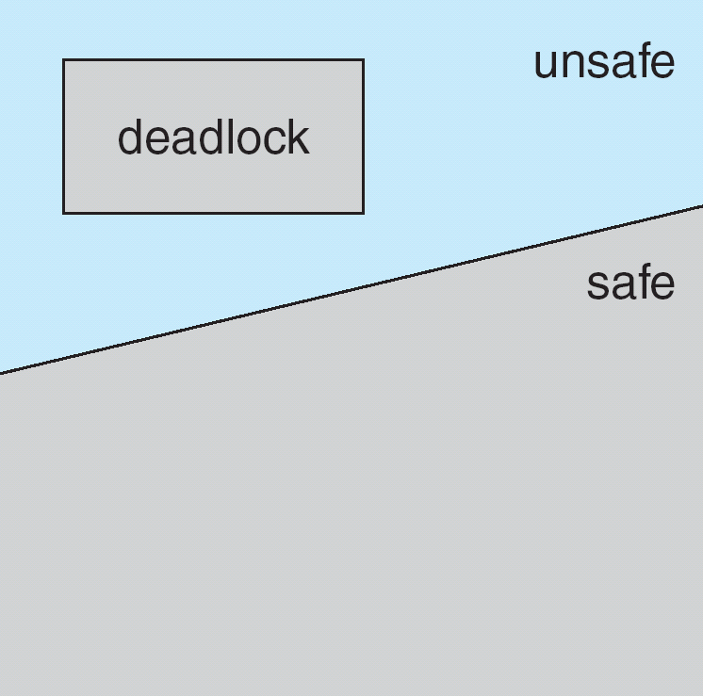
Safe, Unsafe, Deadlock State

Slide 29
Avoidance algorithms
Single instance of a resource type
Use a resource-allocation graph
Multiple instances of a resource type
Use the banker’s algorithm

Slide 30
Resource-Allocation Graph Scheme
Claim edge P_{i} → R_{j} indicated that process P_{j} may request resource R_{j}; represented by a dashed line
Claim edge converts to request edge when a process requests a resource
Request edge converted to an assignment edge when the resource is allocated to the process
When a resource is released by a process, assignment edge reconverts to a claim edge
Resources must be claimed a priori in the system

Slide 31
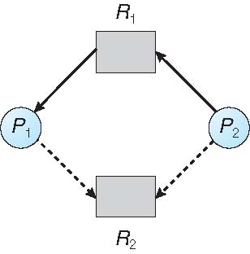
Resource-Allocation Graph

Slide 32
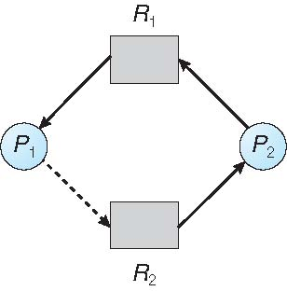
Unsafe State In Resource-Allocation Graph

Slide 33
Resource-Allocation Graph Algorithm
Suppose that process P_{i} requests a resource R_{j}
The request can be granted only if converting the request edge to an assignment edge does not result in the formation of a cycle in the resource allocation graph

Slide 34
Banker’s Algorithm
Multiple instances
Each process must a priori claim maximum use
When a process requests a resource it may have to wait
When a process gets all its resources it must return them in a finite amount of time

Slide 35
Banker’s Algorithm
A small-town banker might deal with a group of customers to whom he has granted lines of credit. (Years ago, banks did not lend money unless they knew they could be repaid.)
What the algorithm does is check to see if granting the request leads to an unsafe state. If so, the request is denied. If granting the request leads to a safe state, it is carried out.

Slide 36
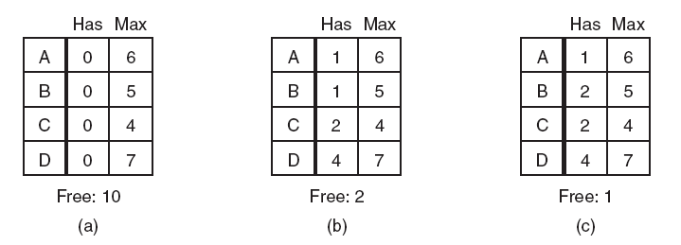
Banker’s Algorithm
Three resource allocation states:(a) Safe. (b) Safe. (c) Unsafe
In the above fig we see four customers, A, B, C, and D, each of whom has been granted a certain number of credit units (e.g., 1 unit is 1K dollars). The banker knows that not all customers will need their maximum credit immediately, so he has reserved only 10 units rather than 22 to service them. (In this analogy, customers are processes, units are, say, tape drives, and the banker is the operating system.)

Slide 37
Data Structures for the Banker’s Algorithm
Let n = number of processes, and m = number of resources types.
Available: Vector of length m. If available [j] = k, there are k instances of resource type R_{j} available
Max: n x m matrix. If Max [i,j] = k, then process P_{i} may request at most k instances of resource type R_{j}
Allocation: n x m matrix. If Allocation[i,j] = k then P_{i} is currently allocated k instances of R_{j}
Need: n x m matrix. If Need[i,j] = k, then P_{i} may need k more instances of R_{j} to complete its task
Need [i,j] = Max[i,j] – Allocation [i,j]

Slide 38
Safety Algorithm
1. Let Work and Finish be vectors of length m and n, respectively. Initialize:
Work = Available
Finish [i] = false for i = 0, 1, …, n- 1
2. Find an i such that both:
(a) Finish [i] = false
(b) Need_{i} ≤ Work
If no such i exists, go to step 4
3. Work = Work + Allocation_{i} Finish[i] = true go to step 2
4. If Finish [i] == true for all i, then the system is in a safe state

Slide 39
Resource-Request Algorithm for Process P_{i}
Request = request vector for process P_{i}. If Request_{i} [j] = k then process P_{i} wants k instances of resource type R_{j}
1. If Request_{i} ≤ Need_{i} go to step 2. Otherwise, raise error condition, since process has exceeded its maximum claim
2. If Request_{i} ≤ Available, go to step 3. Otherwise P_{i} must wait, since resources are not available
3. Pretend to allocate requested resources to P_{i} by modifying the state as follows:
Available = Available – Request;
Allocation_{i} = Allocation_{i} + Request_{i};
Need_{i} = Need_{i} – Request_{i};
If safe ⇒ the resources are allocated to Pi
If unsafe ⇒ Pi must wait, and the old resource-allocation state is restored

Slide 40
Example of Banker’s Algorithm
5 processes P₀ through P₄;
3 resource types:
A (10 instances), B (5instances), and C (7 instances)
Snapshot at time T₀:
Allocation Max Available
A B C A B C A B C
P₀ 0 1 0 7 5 3 3 3 2
P₁ 2 0 0 3 2 2
P₂ 3 0 2 9 0 2
P₃ 2 1 1 2 2 2
P₄ 0 0 2 4 3 3

Slide 41
Example (Cont.)
The content of the matrix Need is defined to be Max – Allocation
Need
A B C
P₀ 7 4 3
P₁ 1 2 2
P₂ 6 0 0
P₃ 0 1 1
P₄ 4 3 1
The system is in a safe state since the sequence < P₁, P₃, P₄, P₂, P₀> satisfies safety criteria

Slide 42
Example: P₁ Request (1,0,2)
Check that Request ≤ Available (that is, (1,0,2) ≤ (3,3,2) ⇒ true
Allocation Need Available
A B C A B C A B C
P₀ 0 1 0 7 4 3 3 3 2
P₁ 3 0 2 0 2 0
P₂ 3 0 2 6 0 0
P₃ 2 1 1 0 1 1
P₄ 0 0 2 4 3 1
Executing safety algorithm shows that sequence < P₁, P₂, P₃, P₄, P₀ > satisfies safety requirement
Can request for (3,3,0) by P₄ be granted?
Can request for (0,2,0) by P₀ be granted?

Slide 43
Deadlock Detection
Allow system to enter deadlock state
Detection algorithm
Recovery scheme

Slide 44
Single Instance of Each Resource Type
Maintain wait-for graph
Nodes are processes
P_{i} → P_{j} if P_{i} is waiting for P_{j}
Periodically invoke an algorithm that searches for a cycle in the graph. If there is a cycle, there exists a deadlock
An algorithm to detect a cycle in a graph requires an order of n² operations, where n is the number of vertices in the graph

Slide 45
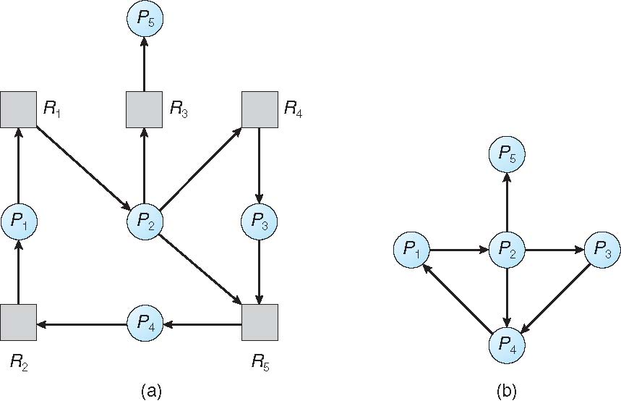
Resource-Allocation Graph and Wait-for Graph
Resource-Allocation Graph
Corresponding wait-for graph

Slide 46
Several Instances of a Resource Type
Available: A vector of length m indicates the number of available resources of each type.
Allocation: An n x m matrix defines the number of resources of each type currently allocated to each process.
Request: An n x m matrix indicates the current request of each process. If Request [i][j] = k, then process P_{i} is requesting k more instances of resource type.R_{j}.

Slide 47
Detection Algorithm
1. Let Work and Finish be vectors of length m and n, respectively Initialize:
(a) Work = Available
(b) For i = 1,2, …, n, if Allocation_{i} ≠ 0, then Finish[i] = false; otherwise, Finish[i] = true
2. Find an index i such that both:
(a) Finish[i] == false
(b) Request_{i} ≤ Work
If no such i exists, go to step 4

Slide 48
Detection Algorithm (Cont.)
3. Work = Work + Allocation_{i} Finish[i] = true go to step 2
4. If Finish[i] == false, for some i, 1 ≤ i ≤ n, then the system is in deadlock state. Moreover, if Finish[i] == false, then P_{i} is deadlocked
Algorithm requires an order of O(m x n²⁾ operations to detect whether the system is in deadlocked state

Slide 49
Example of Detection Algorithm
Five processes P₀ through P₄; three resource types A (7 instances), B (2 instances), and C (6 instances)
Snapshot at time T₀:
Allocation Request Available
A B C A B C A B C
P₀ 0 1 0 0 0 0 0 0 0
P₁ 2 0 0 2 0 2
P₂ 3 0 3 0 0 0
P₃ 2 1 1 1 0 0
P₄ 0 0 2 0 0 2
Sequence <P₀, P₂, P₃, P₁, P₄> will result in Finish[i] = true for all i

Slide 50
Example (Cont.)
P₂ requests an additional instance of type C
Request
A B C
P₀ 0 0 0
P₁ 2 0 2
P₂ 0 0 1
P₃ 1 0 0
P₄ 0 0 2
State of system?
Can reclaim resources held by process P₀, but insufficient resources to fulfill other processes; requests
Deadlock exists, consisting of processes P₁, P₂, P₃, and P₄

Slide 51
Detection-Algorithm Usage
When, and how often, to invoke depends on:
How often a deadlock is likely to occur?
How many processes will need to be rolled back?
one for each disjoint cycle
If detection algorithm is invoked arbitrarily, there may be many cycles in the resource graph and so we would not be able to tell which of the many deadlocked processes “caused” the deadlock.

Slide 52
Recovery from Deadlock: Process Termination
Abort all deadlocked processes
Abort one process at a time until the deadlock cycle is eliminated
In which order should we choose to abort?
Priority of the process
How long process has computed, and how much longer to completion
Resources the process has used
Resources process needs to complete
How many processes will need to be terminated
Is process interactive or batch?

Slide 53
Recovery from Deadlock: Resource Preemption
Selecting a victim – minimize cost
Rollback – return to some safe state, restart process for that state
Starvation – same process may always be picked as victim, include number of rollback in cost factor.
In starvation, threads are also waiting for each other. But here waiting time is not infinite after some interval of time, waiting thread always gets the resources whatever is required to execute thread run() method.

Slide 54
Other Issues
Two-phase locking
Communication deadlocks
Livelock

Slide 55
Two-phase locking
In the first phase, the process tries to lock all the records it needs, one at a time. If it succeeds, it begins the second phase, performing its updates and releasing the locks. No real work is done in the first phase.
If during the first phase, some record is needed that is already locked, the process just releases all its locks and starts the first phase all over.

Slide 56
Communication Deadlocks
Two or more processes communicate by sending messages. A common arrangement is that process a sends a request message to process B, and then blocks until B sends back a reply message.
Suppose that the request message gets lost. A is blocked waiting for the reply. B is blocked waiting for a request asking it to do something. We have a deadlock.

Slide 57
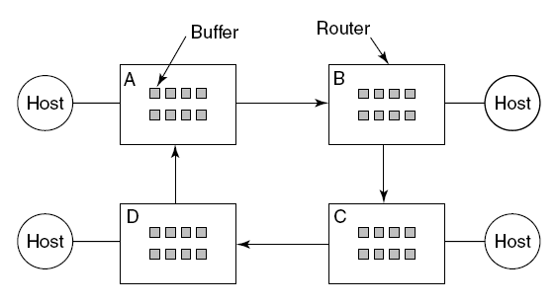
Communication Deadlocks
Figure 6-15. A resource deadlock in a network.
A resource deadlock in a network

Slide 58
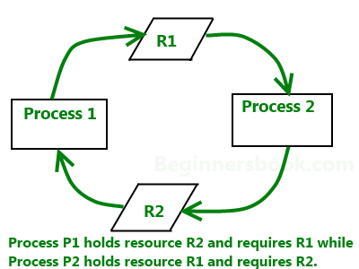
Livelock
Livelock occurs when two or more processes continually repeat the same interaction in response to changes in the other processes without doing any useful work. These processes are not in the waiting state, and they are running concurrently. This is different from a deadlock because in a deadlock all processes are in the waiting state.

Slide 59
End

